Slide 1
Chapter 7 & 8
Energy and Conservation Law
Work and Power
2. Kinetic Energy & Work- Energy Principle
3. Conservative and Nonconservative Forces
4. Potential Energy
5. Conservation of Energy

Slide 2


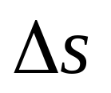
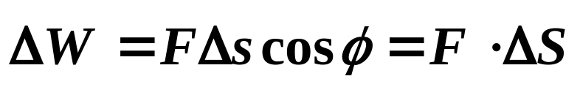
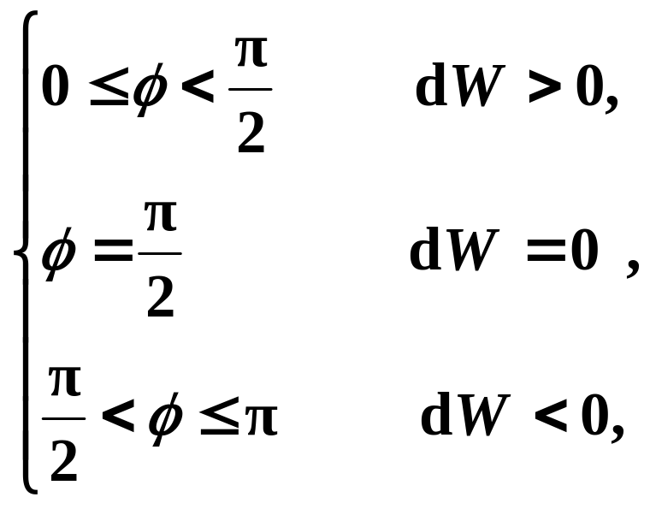
7-1 Work and Power (P147-)
1. Work
研究力和运动的空间过程关系。
The work done by a force in displacing a body as the scalar product of and .
质点受的力与它的位移的标积
Work is a scalar quantity, no direction.
positive work;
zero work;
negative work.

Slide 3
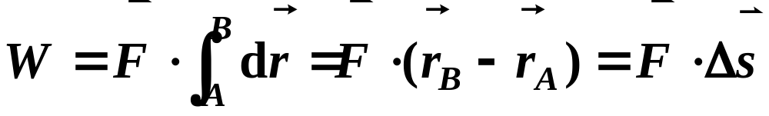


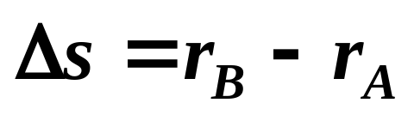


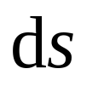


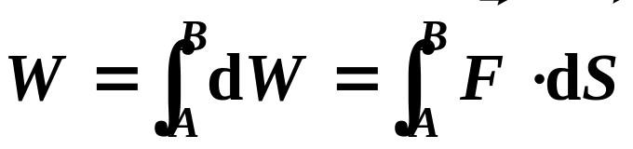
Explanations:
(1) If the force is constant in the whole path,
A
—displacement from A to B
B
o
(2) Work done by a variable force:
When a particle moves from A to B along a curve path, the total work done by the force equals the integral of from A to B:
B
A

Slide 4
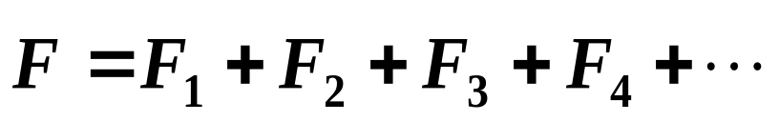
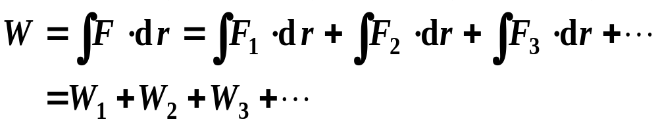
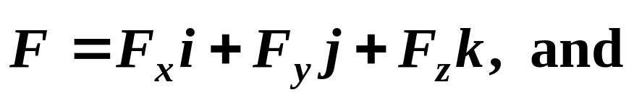
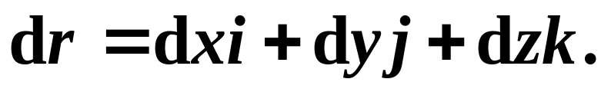
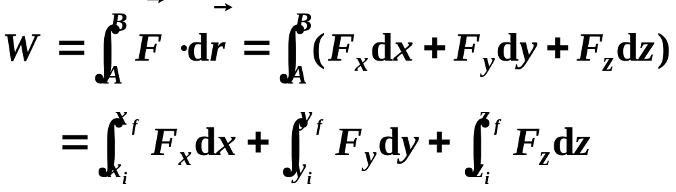
(3) Work done by several forces:
If
The work done by several forces = algebraic sum of the work done by the individual force.
(4) Special expression in scalar product:

Slide 5
(5) Geometrical representation of work:
The work done by a force equals the area under the F versus x curve —— 变力曲线与位移轴在两点x_{1,} x₂ 之间所包围的面积.
F
x
x₁
dx
x₂
F
F
F
x
x
x
W > 0
W < 0
W = 0
(6) Unit of work:
Dimension is: MLT ^{–2} L= M L² T ^{–2}
In SI system, 1 N·m = 1J (joule) = 1kg·m²/s²

Slide 6
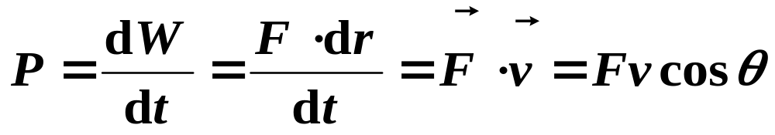
2. Power (功率) (P186)
Instantaneous power:
The instantaneous power P is defined as the rate at which work is performed.
The SI unit of power is the watt,
1 W = 1 J/s
1 horsepower=1 hp = 746 W

Slide 7



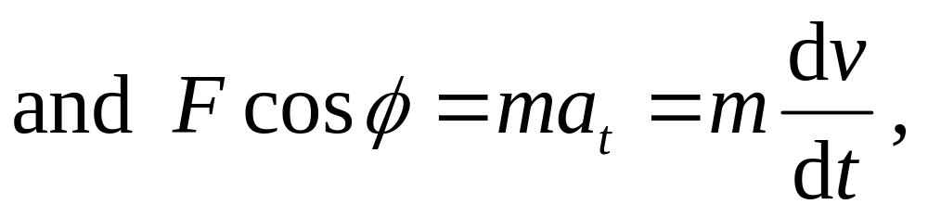

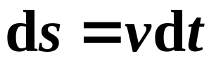

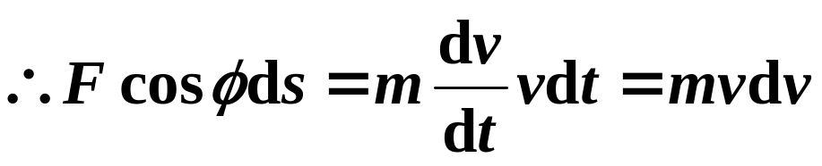


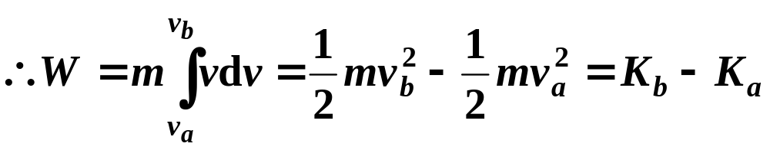
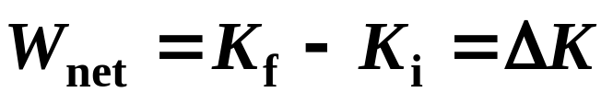
7-2 Work-Kinetic Energy Theorem (P156-)
A particle moves from a to b along an arbitrary path. and may vary from point to point along the path.
❒
d
s
b
a
That is,

Slide 8
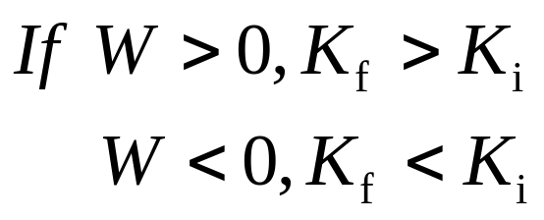
Net work done on an object equals to the change in its kinetic energy.
Explanations:
(1) Work is the measurements for the change in the kinetic energy (K) of a body.
——Body gains the kinetic energy.
—Body loses “K” & does work outside.
(2) Both work and “K” are scalars. They have same units and dimensions; “K” only depends on the speed of initial and final states, but work depends on the real process(动能是状态量,功是过程量).

Slide 9
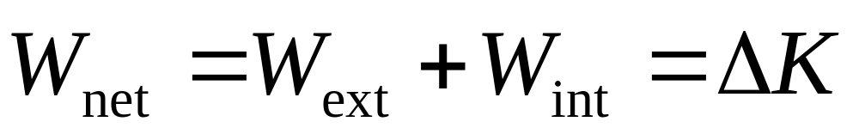
(3) For a system with more particles, work-kinetic energy theorem should be: The sum work done on a system by all external and internal forces equal to the change in kinetic energy of the system (质点系动能定理系统外力和内力做功总和等于系统动能的增量).
(4) Both W and K depend on RF. Work-kinetic energy theorem is only hold for inertial RF.
Look at examples in Sec.7-4 after class.

Slide 10






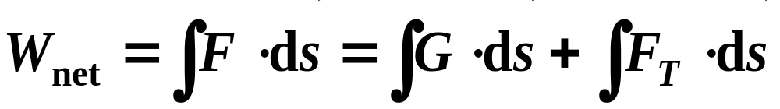
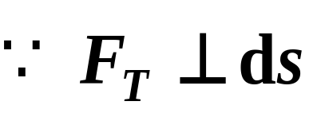
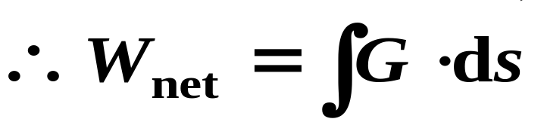
Example:
O
A simple pendulum of mass m=1kg is released from position θ_{o}=30º. It moves in a circular arc of radius R=1m in a vertical plane. Use the work-kinetic energy theorem to determine the speed of the pendulum bob at the angle θ=10^{o.}
R
❒
F_{T}
ds
❒
: constant
F_{T}
: variable
Solution:

Slide 11
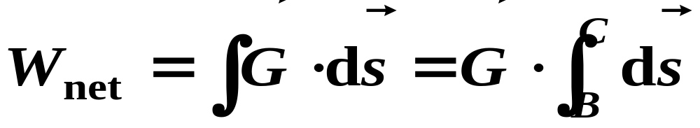

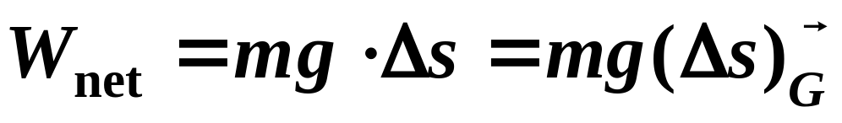
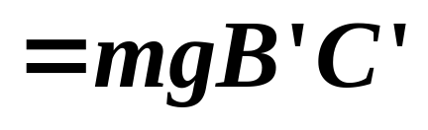
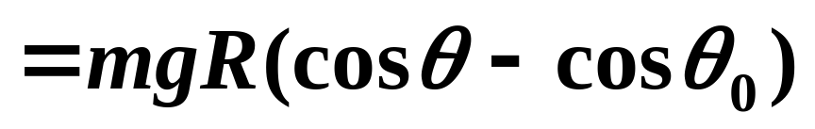
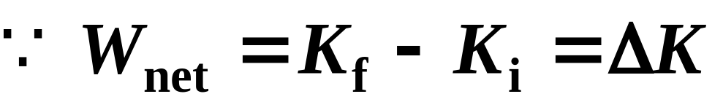
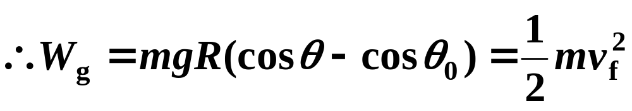
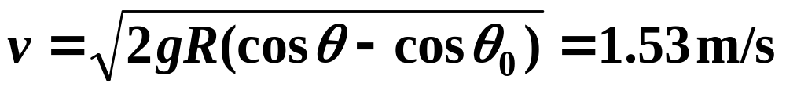
O
R
❒
F_{T}
B′
B
C′
C〞
A
C

Slide 12
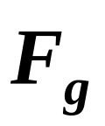

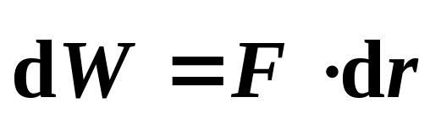
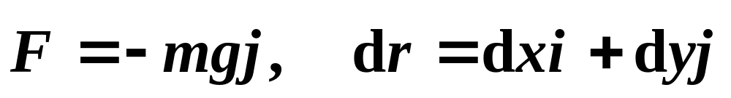
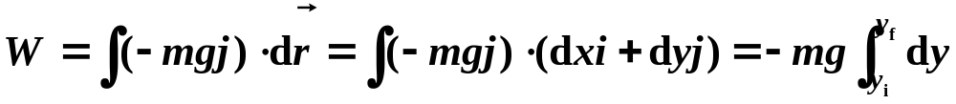
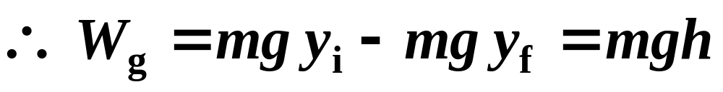
7-3 Conservative and Nonconservative Forces
1. Work done by and its features
(P168)
Considering a body under mg near the surface of Earth, from a to b along the path of acb.
y
a
e
y_{i}
h
c
mg
y_{f}
d
b
o
x
The work done by the gravity:

Slide 13
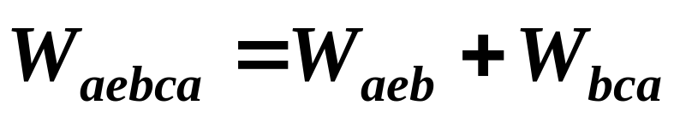
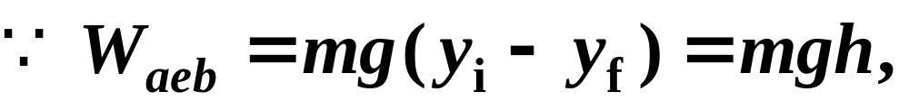
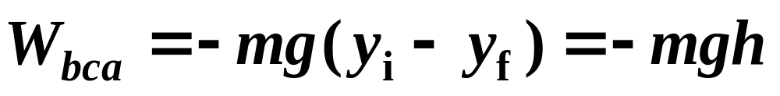
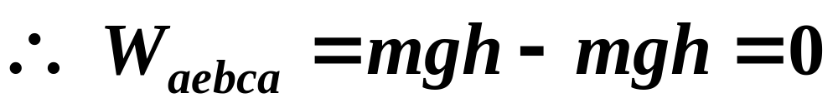
The feature of the gravity:
W_{g} on a particle depends only on the initial and final position (or height), and does not depend on the real path taken by the particle.
1.
2.
W_{g} on a particle moving around a closed path=0.
y
a
e
y_{i}
h
c
mg
y_{f}
d
b
o
x

Slide 14
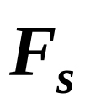

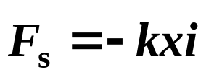
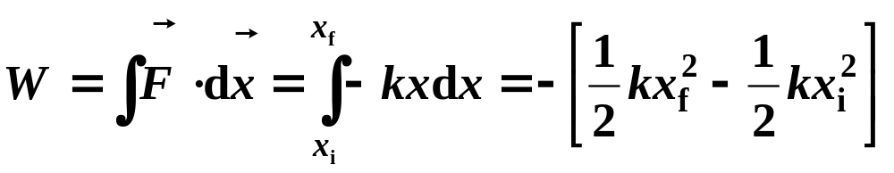
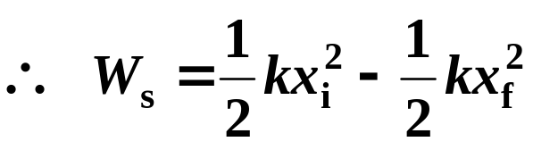
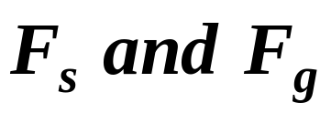
2. Work done by and its features (P172)
Based on Hooke’s law:
x
O
A
B
x_{i}
x_{f}
have the same features!
3. Conservative & nonconservative forces
Mathematically, the two common features of can be written as:
❖
❖
F
and
F
s
g

Slide 15
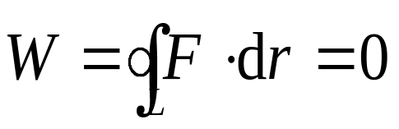
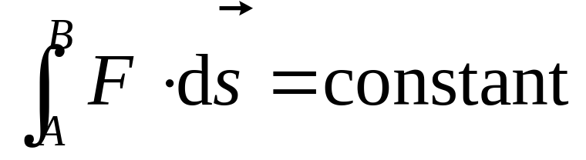
Definition 1:
The net work done by conservative force (保守力) on a particle moving around any closed path is zero.
Definition 2:
Work done by a conservative force is recoverable or independence of paths (与路径无关).
These two definitions are equivalent and powerful because they allow us to simplify difficult problems when only conservative forces are involved.

Slide 16
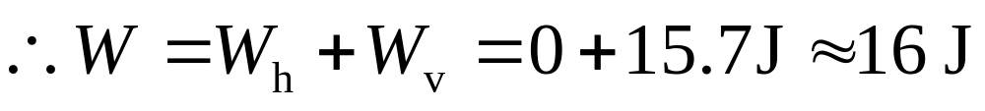
Example:
a
A 2.0kg block slides along a frictionless track from point a to b. It travels through a total distance of 2.0m along the track, and a net vertical distance of 0.80m. How much work is done on it by the gravitational force during the slide?
b
a
b
Solution:

W
=
mgd
cos
0
°
=
15
.
7
J
v

Slide 17
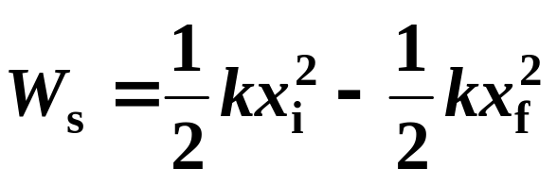
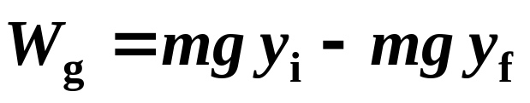
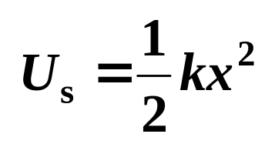

7- 4 Potential Energy (P170)
If we define a work-function —— U as
Then,
W
=
−
(
U
−
U
)
=
−
Δ
U
conser
f
i
The work done by conservative force = minus change of “U” related to the conservative force (保守力作功等于该过程始末两状态势能增量的负值).
Look at example 8-1 of P171

Slide 18


Explanations:
1.
“U” is the function of states.
2.
The relativity of potential energy:
W_{ab}=U_{a}- U_{b}—— The difference of potential energy (“U”) has absolute meaning, but to assign a particular U value to an object makes sense only if the reference “U” value is given. Reference of “U” is arbitrary to choose.
Definition of U:
势能是保守力对路径的线积分
3.
A potential energy is associated with a system as a whole (相互作用能).

Slide 19

If work done by force is dependent on the path.
❒
❒
∫
F
d
r
≠
0.
The is called nonconservative force.
•
L
A nonconservative force is also called dissipative force (耗散力), such as a friction force.
In general,
Δ
E
=
F
s
th
f
The work done by frictional force equals to the increase in thermal energy.

Slide 20





7-5 Work-Energy Principle
In physics, energy have different forms. One form of energy can transfer to another form, but it can not magically appear or disappear. They obey a law called the law of Conservation of Energy.
1. Work-energy principle
A, B & the Earth as a system
(1)
❒
F_{AB}
∑
W
=
W
+
W
and
∑
W
=
W
int
c
i
nc
i
ext
ext
A
i
❒
❒
i
Internal Force:
B
F
,
F
❒
AB
BA
F_{BA}
External Force:
0

Slide 21




(2)
(3)
(4)
or
—Work-energy principle
—mechanical energy of a system.
2. The law of conservation of energy (P174)
1.
If only conservative forces do work, mechanical energy conserves —— both kinetic energy and potential energy transfer each other.

Slide 22

2.
The total energy of a system can change only by amounts of energy that are transferred to or from the system.
3.
For isolated system, if a system is isolated from its environment, then there can be no energy transfers to or from it.
The total energy E of an isolated system cannot
change —— conservation of energy.

Slide 23




Example:
A crate of mass 180kg is released that was being held at rest at the top of a 3.7m-long-ramp inclined 39º to the horizontal. = 0.28 (a) How fast is the crate moving as it reaches the bottom of the ramp? (b) How far will it subsequently slide across the floor? (c) Do the answers to them change if we halve the mass of the crate?
Solution:
(a)
F_{N}
=
∴
=
μ
=
μ
F

F_{N}
mg
cos
θ
F
F_{N}
mg
cos
θ
k
k
k
B
mg
C
A
s

Slide 24


N
f
B
1
−
μ
mgd
cos
θ
=
mv
2
−
mgd
sin
θ
mg
k
2
C
A
s
∴
v
=
2
gd
(sin
θ
−
μ
cos
θ
)
=
5
.
5
m
/
s
k
(b)
1
−
μ
mgs
=
0
−
mv
2
=
−
mgd
(sin
θ
−
μ
cos
θ
)
k
2
k
∴
s
=
d
(sin
θ
−
μ
cos
θ
)
/
μ
=
5
.
4
m
k
k
Answer:
(c)
From the algebraic form of the results, it can be seen that the answers do not depend on mass.

Slide 25






Example:
A chain has length L and mass M, and was put on a frictionless table. At t = 0, the chain is stationary and length d is hanged over the edge. At the moment that the whole chain leave the table, what is the (a) W_{g} and (b) the velocity of the chain ?
Solution:
(a)
The way:
1.
F_{N}
L-d
O
G₂
x
x
G₁

Slide 26



(b)
Earth, table and chain as a system, E_{mec} = C
The way:
2.
Applying the Kinetic-energy theorem, only W_{g,}
∴
Δ
K
=
W
net
1
Mg
F_{N}
W
=
W
=
Δ
K
=
Mv
2
=
(
L
2
−
d
2
)
L-d
U=0
net
G
2
2
L
O
If the friction coefficient of table’s surface is μ, how about the v
G₂
x
?
x
G₁

Slide 27

7-6 Potential Energy Diagrams
1. Relation between force and potential (P173)
W
=
−
[
U
−
U
]
=
−
Δ
U
has two sides of information:
conser
f
i
Calculate U or ΔU when the force is given;
1.
❒
❒
r
U
=
∫
o
F
⋅
d
r
where
p
conser
r
P
❒
❒
Δ
=
−
=
−
∫
f
⋅
U
W
F
d
s
conser
i
conser

Slide 28





Finding force analytically (由势能求保守力)
2.
If we consider a 1D system in which U depends only on x, U =U(x), a graph can then be drawn of U versus x.
sin
ce
Δ
x
=
x
−
x
,
Δ
U
(
x
)
≅
−
F
(
x
)
Δ
x
f
i
The component of F in the x-direction, F(x), is the negative of the slope of the U versus x curve.
For general case, U=U(x, y, z)
U (x)
E
O
x

Slide 29

A conservative force equals to minus gradient of the potential energy related to the force 保守力沿某一给定的 l 方向的分量等于与此保守力相应的势能函数沿l 方向的空间变化率(梯度).
Hey!
You may find both magnitude and direction of a conservative force at any point in a conservative-force-field from potential energy diagram!

Slide 30





A special case:
Gravitational potential energy (Sec.8-7)
mM
=
−
G
E
(
r
>
r
)
r
2
E
Let U = 0 for r = ∞, the U of system for particle in position r is given by:
—— gravitational potential energy

Slide 31

Discussions:
U
势能曲线
The U - r curve of gravitational potential energy as the Figure showing:
O
1.
r
2.
The work done by the gravitational force is independent of the path, so gravitation is also a conservative force.

Slide 32

2. Equilibrium points and turning points (P189)
A potential energy U(x) diagram is as follows:
The total energy E = U + K = constant
and can be represented as a horizontal line on this graph.

Slide 33
Corresponds to the point x₀ at which dU(x₀)/dx=0,
i.e., F(x₀)=0 ——Equilibrium Points
x₀, x_{4,} x₇ satisfy this condition. That is, they are equilibrium points.
U
(
J
),
E
(
J
)
mec
However, x₀, x₇ are stable equilibrium points, x₄ is an unstable equilibrium point and x₆ is neutral equilibrium.
x₇
(E=U, so K=0, F=0, Particle must be stationary).

Slide 34


Example:
(P184)
Find the escape velocity v of a satellite (the minimum initial speed needed to prevent it from returning to the Earth 第二宇宙速度) of mass m, is projected into the air from the Earth (M_{E}, R_{E} ).
Solution:
System: Earth + satellite → E_{mec} = C

Slide 35






Near the Earth,
The greater the velocity, the higher the satellite can reach.
When R_{E} >> h，
第一宇宙速度
Minimum initial speed of rotating around the Earth.

Slide 36



If the speed is high enough, it will continue out into space never to return to Earth.
Then h→∞, with merely zero speed,
Reading sections 8-7 after class, please!

Slide 37
The problems of chapter 7:
34, 36, 37, 38, 53, 57, 67, 69, 70, 76
The problems of chapter 8:
6, 7, 23, 24, 35, 68, 69

